Slide 1
June 2018
Rauha Maarno, Executive Director
Finnish Library Association
Public Libraries
in finland

Slide 2
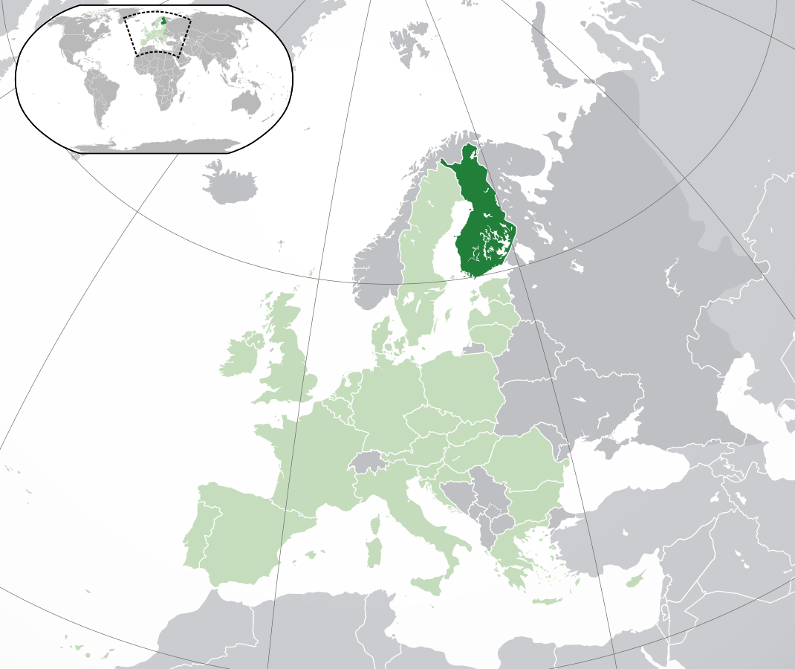
This is
Finland
▪ Population of 5,5 million people. Location in Northern Europe, shares boarders with Sweden, Norway and Russia.
▪ In Finland we have the most used and best libraries in the world.
Picture: Wikipedia

Slide 3
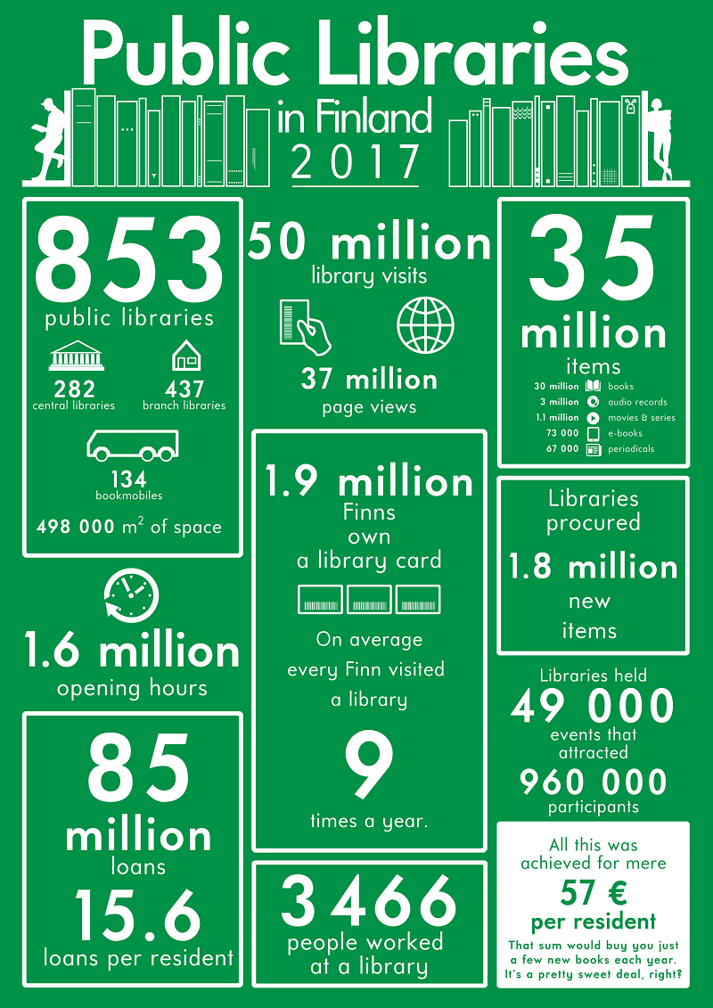
Facts &
Figures

Slide 4
A few more facts…
▪ Public libraries in Finland are funded by municipalities (75 %)
and state (25 %). On average the cost is 57 € per resident (2017).
▪ The success of libraries is based on law and public funding, excellent service design, educated staff and thinking out of the box. And the fact that the Finns just love their libraries!
▪ In Finland, libraries are not simply places to study, read or borrow books – they are vital places for socializing.
▪ Libraries contribute in many ways to the success of reading and literary culture. Libraries host multiple services connected to reading such as books clubs, social media reading circles, author visits etc. There even are personal trainers for reading!

Slide 5
VALUES of libraries
▪ Free for everyone!
▪ Freedom of expression!
▪ Instrument of democracy!
▪ Supporting communities!

Slide 6
Legal Framework
▪ The Library Act (reformed recently in 2017, the first act is from 1928)
▪ Libraries are free of charge for users.
▪ By law, every municipality has to have a library with collections and trained staff.
▪ Library is a basic service comparable to schools and health care.
▪ Tasks of the public library include by law:
▪ Provide access to collections, information and culture.
▪ Advance reading and literature.
▪ Provide information service and support in information seeking.
▪ Provide space for learning, working and hobbies.
▪ Advance societal and cultural dialogue in the society.

Slide 7
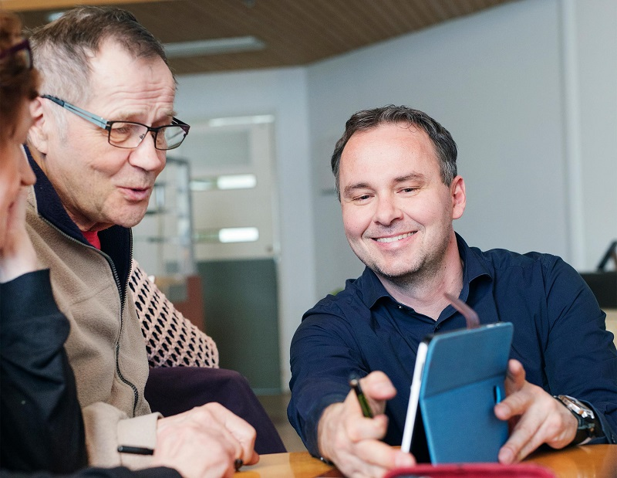
Partners for libraries
▪ Schools and day care and other municipal services
▪ Non-profit organizations
▪ Other libraries
▪ Coming up: volunteers
Photo: Lauri Rotko

Slide 8
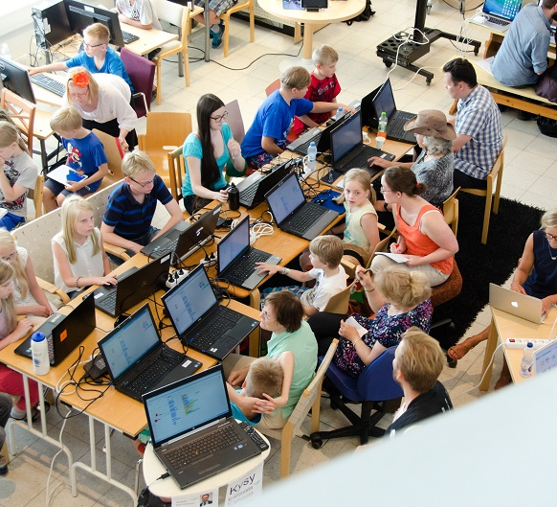
literacy
and skills
▪ Early literacy: libraries, day care and schools work together
▪ Reading for fun is the key to success in studies
▪ Library advances also ICT skills
▪ 23 % of public library users took part in educational activities at the library in Finland (2017)
Photo: Espoo City Library

Slide 9
From collections to connections
▪ According to studies from nordic countries (Denmark, Norway) 55–60 % of library users are not lending books.
▪ Using libraries for meetings, reading magazines, participating educational and cultural activities etc.
▪ Library as a place for people!

Slide 10
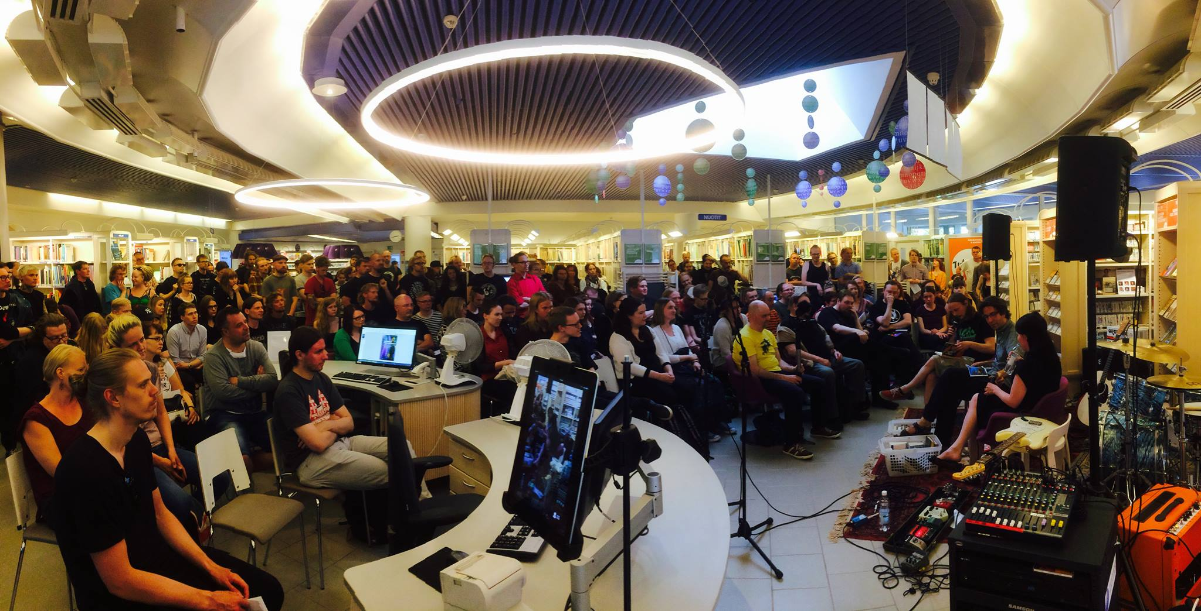
Photo: Tampere City Library

Slide 11
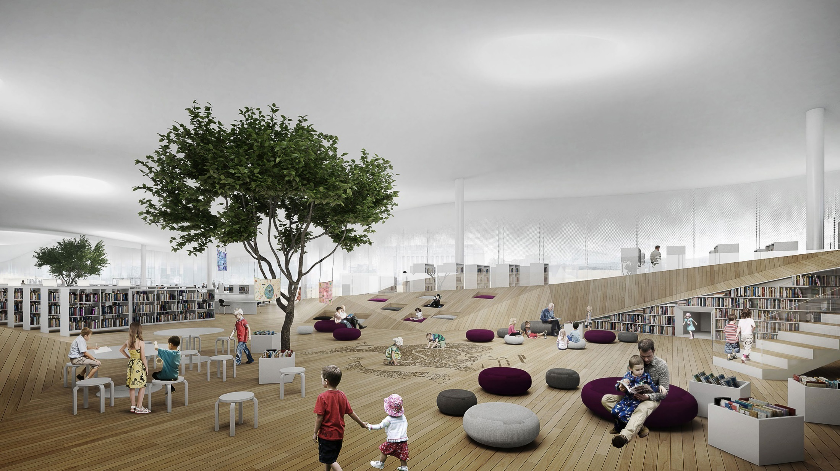
Photo: New Central Library in Helsinki, will be opened in 2018, ALA Architects

Slide 12
Need more info?
Contact me:
Rauha Maarno
Finnish Library Association
rauha.maarno@fla.fi
Follow us on Facebook:
facebook.com/kirjastoseura/

